Slide 1
Common Fish Illnesses
Select the illness that your fish is/are showing and a full description of the illness characteristics and treatments will be displayed.
Slime Patches
Swollen Eyes
Fungus
Mouth Rot
Ragged Fins
Rapid Gill Movements
Protruding Scales
“Ich”
Important Info:
pH
Hardness
Ammonia, Nitrite, Nitrate
Ideas for this illustration were taken from Stuart Thraves Setting up a Tropical Aquarium Week by Week
References
Notes:
By Samantha Toivonen and Dexter Wilson

Slide 2
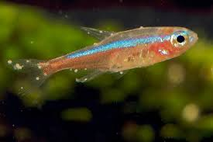
“Ich” Freshwater White Spot Disease
Symptoms
Small white spots
Cause
Most Common fish illness
Ichthyopthirius multifillis- (protozoan parasite)
Treatment
Treatment only affects free swimming stage
Raise water temperature a few degrees then life cycle will be faster so the disease can be stopped in less time
Addition of an anti-parasitical medication (note: with medication always do a 25% overall water change after infection is clear)
hisstoryimmortalised.blogspot.com
Master Slide

Slide 3
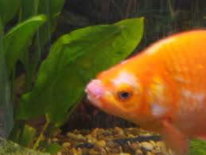
Mouth Rot
Signs
Acute: sudden death
Chronic: white, fluffy fungus tufts for lesions. Bacterial lesions are coarser and grayer.
Cause
Flexibacter collumnaris
Transmission- bacteria commonly present
Factors- Existing injury or disease on mouth, incorrect pH, high nitrate levels, low oxygen concentrations, vitamin defficiency
Treatment
Phenoxyethanol bath
Anti-bacterial medication (note: with medication always do a 25% overall water change after infection is clear)
www.tropical-fish-centre.com
Master Slide

Slide 4
Rapid Gill Movements
Cause
High nitrite- water quality
Parasite
Bacterial infection
Treatment
Improve water quality
Medication (note: with medication always do a 25% overall water change after infection is clear)
Prevention
Good water quality
Master Slide

Slide 5
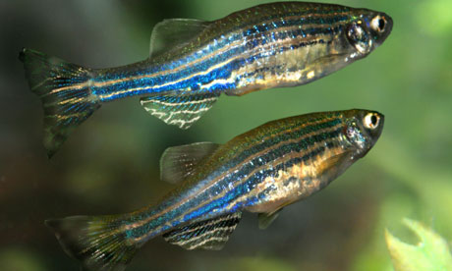
Swollen Eyes
Signs
Cause
Treatment
Fish eyes appear to be bulging out
Bacterial infection
Injury
Water quality
Maintain water quality
If bacterial infection then antibiotics can be applied (note: with medication always do a 25% overall water change after infection is clear)
www.aquaticabiotech.com
Master Slide

Slide 6
Slime Patches
Signs
Cause
Treatment
Can be seen as globs of slime on the fish
Fish’s immune response to a parasite
Addition of an anti-parasite to the fish tank (note: with medication always do a 25% overall water change after infection is clear)
Maintain water quality
hubpages.com
Master Slide

Slide 7
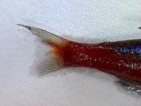
Ragged Fins
Signs
Fish fins appear unmaintained, notched or even mangled.
Fish can be seen struggling to swim or stationary at bottom of tank.
Cause
Treatment
Aggressive fish in the tank.
Not enough space for all of the fish causing territory confrontations.
Bacterial infection.
Remove aggressive fish, or isolate them with a divider.
Add plants or cover for weaker fish to hide.
Add anti-bacterial medication to fish tank. (note: always do a 25% overall water change after infection is clear)
freshaquarium.about.com
Master Slide

Slide 8
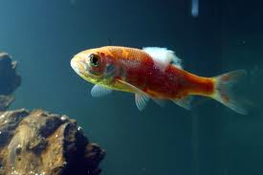
Fungus
Signs
Cause
Treatment
Can be seen as fuzzy patches on the skin of the fish
Lacerations or damage to the skin of a fish can become infected with fungus or bacteria
Add anti-fungal to tank (note: always do a 25% overall water change after infection is clear)
Keep water quality maintained for quick recovery of the fish and it’s immune system
karachiaqua.blogspot.com
Master Slide

Slide 9
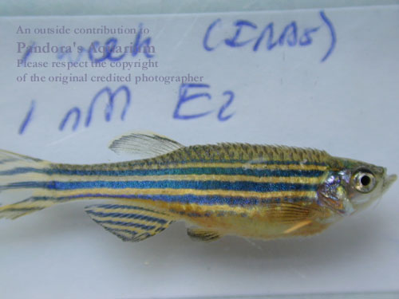
Protruding Scales
Signs
Cause
Treatment
Scales on the fish are protruding from the skin
Also known as a fish disease called dropsy that is caused by a bacterial infection
Addition of an anti-bacterial medication (note: always do a 25% overall water change after infection is clear)
badmanstropicalfish.com
Master Slide

Slide 10
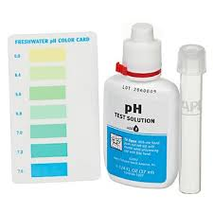
pH
Importance
Testing
Maintenance
Important for spawning- most freshwater fish will not breed without the optimal pH for their species
Prevent fish illness by keeping stress levels low and maintaining healthy immune system
Use pH test kit
Fish tanks as a standard have a pH of 5.5-8.5
For zebrafish the pH should be around 5.0-7.0
www.petco.com
Master Slide

Slide 11
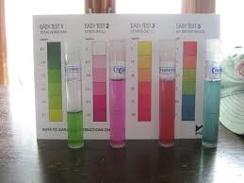
Ammonia, Nitrite, Nitrate
Importance
Testing
Maintenance
Biological filtration – Nitrogen cycle
Healthy aquarium ecosystem
Prevent fish illness
Use test kits
Test weekly
Test daily when new fish are added, because the addition of fish will make levels of ammonia, nitrite and nitrate spike due to the increase in biological waste
synaptoman.wordpress.com
Master Slide

Slide 12
Water Hardness
Importance
Testing
Maintenance
Prevent fish illness by maintaining healthy water hardness levels
Determines pH levels of water
The amount and type of minerals dissolved in the water will determine the pH
7-12 dH (based on CaCO3)
0-4 very soft
4-8 soft
8-12 medium
12-20 Hard
20+ very hard
Soft water has less dissolved minerals- usually low pH
Hard water has more dissolved minerals- usually high pH
City water- usually has added fluorides and salts that are toxic to freshwater fish. Treat water before adding fish.
Well water- Usually does not have additives, water pH may need to be adjusted but is not always toxic for tropical fish.
Bottled water- do not use deionized water. Bottled spring water is safest for tropical fish because pH is neutral.
Master Slide

Slide 13
References
Thraves, Stuart. (2004) Setting up a Tropical Aquarium Week by Week. Firefly Books Ltd.
Sharpe, Shirlie. "Ichthyophtirius multifillis - Ich." http://freshaquarium.about.com/cs/disease/p/ich.htm
"Fish Pop-Eye."http://www.fishlore.com/aquariummagazine/dec07/fish-popeye.htm
Common Aquarium Fish Bacterial Infections: Causes, Symptoms, and Treatment."
http://www.peteducation.com/article.cfm?c=16+2160&aid=584
"Disease Treatment." http://fish.mongabay.com/diseases.htm
http://www.drsfostersmith.com/pic/article.cfm?aid=2303
http://www.liveaquaria.com/PIC/article.cfm?aid=60
Master Slide

